Slide 1
Introducción a Álgebra Lineal
Mtro. René Rosado González
Director de Programa LTP

Slide 2

Sistemas de Ecuaciones Lineales
Un sistema de $m$ ecuaciones lineales en $n$ variables:
$$\begin{matrix}a_{11}x_{1}+a_{12}x_{2}+…+a_{1n}x_{n}=b_{1} \\ a_{21}x_{1}+a_{22}x_{2}+…+a_{2n}x_{n}=b_{2} \\ \begin{aligned}⋮ \\ a_{m1}x_{1}+a_{m2}x_{2}+…+a_{mn}x_{n}=b_{m}\end{aligned}\end{matrix}$$
Puede ser expresado como un conjunto de matrices y vectores
$$Ax=\left[\begin{matrix}a_{11} & a_{12} & … \\ a_{21} & a_{22} & … \\ \begin{matrix}⋮ \\ a_{m1}\end{matrix} & \begin{matrix}⋮ \\ a_{m2}\end{matrix} & \begin{matrix}⋱ \\ …\end{matrix}\end{matrix} \begin{matrix}a_{1n} \\ a_{2n} \\ \begin{matrix}⋮ \\ a_{mn}\end{matrix}\end{matrix}\right]\left[\begin{matrix}x_{1} \\ x_{2} \\ \begin{matrix}⋮ \\ x_{m}\end{matrix}\end{matrix}\right]=\left[\begin{matrix}b_{1} \\ b_{2} \\ \begin{matrix}⋮ \\ b_{m}\end{matrix}\end{matrix}\right]=b$$

Slide 3
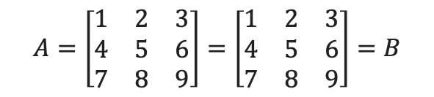
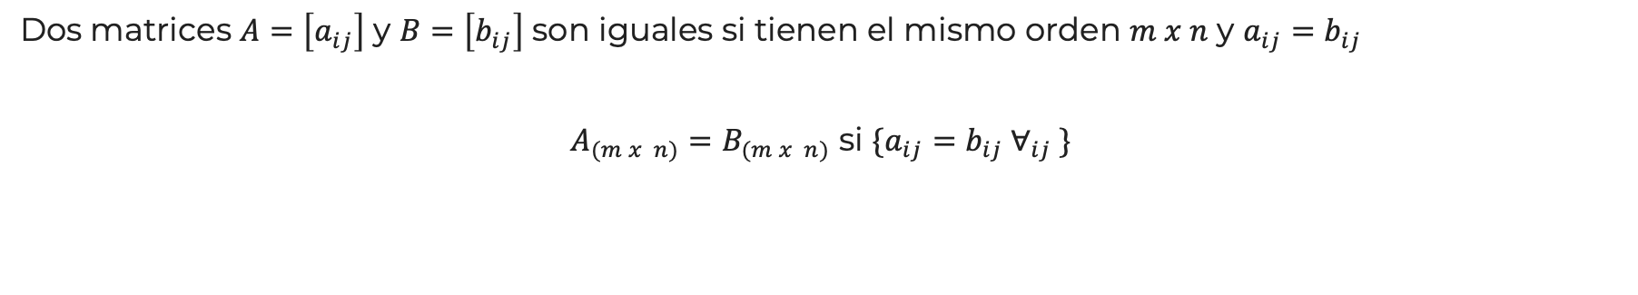
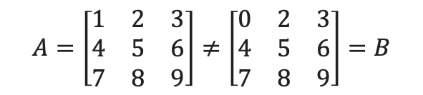
Igualdad de Matrices
Dos matrices $A=\left[a_{ij}\right]$ y $B=\left[b_{ij}\right]$ son iguales si tienen el mismo orden $m x n$ y $a_{ij}=b_{ij}$
$A_{(m x n)}=B_{(m x n)}$ si $\{a_{ij}=b_{ij} ∀_{ij} \}$
$$A=\left[\begin{matrix}1 & 2 & 3 \\ 4 & 5 & 6 \\ 7 & 8 & 9\end{matrix}\right]=\left[\begin{matrix}1 & 2 & 3 \\ 4 & 5 & 6 \\ 7 & 8 & 9\end{matrix}\right]=B$$
$$A=\left[\begin{matrix}1 & 2 & 3 \\ 4 & 5 & 6 \\ 7 & 8 & 9\end{matrix}\right]≠\left[\begin{matrix}0 & 2 & 3 \\ 4 & 5 & 6 \\ 7 & 8 & 9\end{matrix}\right]=B$$

Slide 4

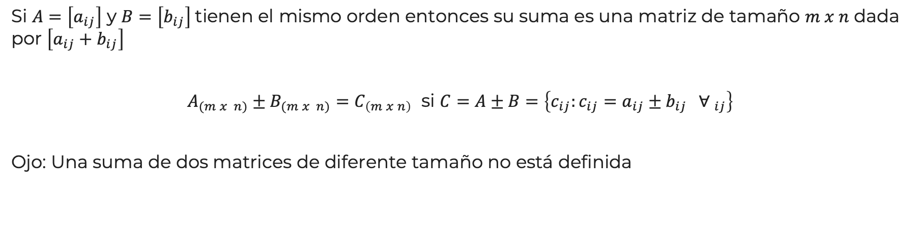
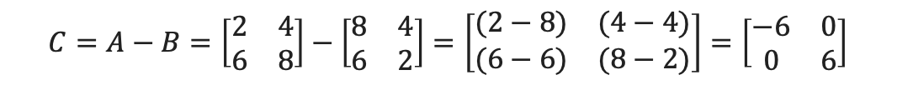
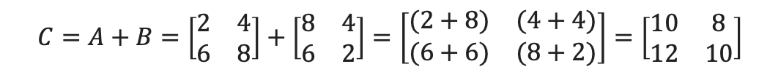

Suma y Resta de Matrices
Si $A=\left[a_{ij}\right]$ y $B=\left[b_{ij}\right]$tienen el mismo orden entonces su suma es una matriz de tamaño $m x n$ dada por $\left[a_{ij}+b_{ij}\right]$
$A_{(m x n)}±B_{(m x n)}=C_{\left(m x n\right)}$ si $C=A±B=\left\{c_{ij}:c_{ij}=a_{ij}±b_{ij} { ∀ }_{ij}\right\}$
Ojo: Una suma de dos matrices de diferente tamaño no está definida
$$A=\left[\begin{matrix}2 & 4 \\ 6 & 8\end{matrix}\right]$$
$$C=A+B=\left[\begin{matrix}2 & 4 \\ 6 & 8\end{matrix}\right]+\left[\begin{matrix}8 & 4 \\ 6 & 2\end{matrix}\right]=\left[\begin{matrix}(2+8) & (4+4) \\ (6+6) & (8+2)\end{matrix}\right]=\left[\begin{matrix}10 & 8 \\ 12 & 10\end{matrix}\right]$$
$$B=\left[\begin{matrix}8 & 4 \\ 6 & 2\end{matrix}\right]$$
$$C=A−B=\left[\begin{matrix}2 & 4 \\ 6 & 8\end{matrix}\right]−\left[\begin{matrix}8 & 4 \\ 6 & 2\end{matrix}\right]=\left[\begin{matrix}(2−8) & (4−4) \\ (6−6) & (8−2)\end{matrix}\right]=\left[\begin{matrix}−6 & 0 \\ 0 & 6\end{matrix}\right]$$

Slide 5



Multiplicación por Escalar
Si $A=\left[a_{ij}\right]$ y $c$un escalar, el múltiplo de $cA=c[a_{ij}]$
$$B_{(m x n)}= {cA}_{(m x n)}=\left\{b_{ij}:b_{ij}={cb}_{ij} { ∀ }_{ij}\right\}$$
Combinaciones lineales de matrices:
Sean ${A_{1}}_{(m x n)},{A_{2}}_{(m x n)},…,{A_{k}}_{(m x n)}$ y una lista de escalares $λ_{1},λ_{2},…,λ_{k}$, podemos construir una matriz $B_{(m x n)}$ que sea una combinación lineal de ellos
$$B_{(m x n)}={{λ_{1}A}_{1}}_{(m x n)}±{{λ_{2}A}_{2}}_{(m x n)}±…±{{λ_{k}A}_{k}}_{(m x n)}$$
$$A=\left[\begin{matrix}2 & 4 \\ 6 & 8\end{matrix}\right]$$
$$B=\left(2\right)\left[\begin{matrix}2 & 4 \\ 6 & 8\end{matrix}\right]=\left[\begin{matrix}4 & 8 \\ 12 & 16\end{matrix}\right]$$
$$c=2$$

Slide 6

Multiplicación de Matrices
Si $A=\left[a_{ij}\right]$ es de dimensión $n x m$y $B=\left[b_{ij}\right]$es dimensión $m x p ,$entonces el producto $AB$ será de dimensiones $n x p$
$A_{(m x n)} B_{(n x p)}=C_{\left(m x p\right)}=[c_{ij}]$
donde $C=\sum_{k=1}^{n}{a_{ik}}b_{ki}=a_{i1}b_{1i}+a_{i2}b_{2i}+…+a_{in}b_{ni}$
Observa que no es lo mismo $AB$ que $BA$
$$A=\left[\begin{matrix}2 & 4 \\ 6 & 8\end{matrix}\right]$$
$$C=AB=\left[\begin{matrix}2 & 4 \\ 6 & 8\end{matrix}\right]\left[\begin{matrix}8 & 4 \\ 6 & 2\end{matrix}\right]=\left[\begin{matrix}\left(2∙8\right)+(4∙6) & \left(2∙4\right)+(4∙2) \\ \left(6∙8\right)+(8∙6) & \left(6∙4\right)+(6∙2)\end{matrix}\right]=\left[\begin{matrix}40 & 16 \\ 96 & 36\end{matrix}\right]$$
$$B=\left[\begin{matrix}8 & 4 \\ 6 & 2\end{matrix}\right]$$

Slide 7

Propiedades de las Operaciones
1. Conmutativa de la suma: $A+B=B+A$
$$A=\left[\begin{matrix}a_{11} & a_{12} \\ a_{21} & a_{22}\end{matrix}\right] , B=\left[\begin{matrix}b_{11} & b_{12} \\ b_{21} & b_{22}\end{matrix}\right]$$
Demostración:
$$\left[\begin{matrix}a_{11} & a_{12} \\ a_{21} & a_{22}\end{matrix}\right]+\left[\begin{matrix}b_{11} & b_{12} \\ b_{21} & b_{22}\end{matrix}\right]=\left[\begin{matrix}a_{11}+b_{11} & {a_{12}+b}_{12} \\ a_{21}+b_{21} & a_{22}+b_{22}\end{matrix}\right]=\left[\begin{matrix}b_{11}+a_{11} & b_{12}+a_{12} \\ b_{21}+a_{21} & b_{22}{+a}_{22}\end{matrix}\right]=\left[\begin{matrix}b_{11} & b_{12} \\ b_{21} & b_{22}\end{matrix}\right]+\left[\begin{matrix}a_{11} & a_{12} \\ a_{21} & a_{22}\end{matrix}\right]$$

Slide 8

Propiedades de las Operaciones
2. Asociativa de la suma: $A+\left(B+C\right)=\left(A+B\right)+C$
$$A=\left[\begin{matrix}a_{11} & a_{12} \\ a_{21} & a_{22}\end{matrix}\right] , B=\left[\begin{matrix}b_{11} & b_{12} \\ b_{21} & b_{22}\end{matrix}\right],C=\left[\begin{matrix}c_{11} & c_{12} \\ c_{21} & c_{22}\end{matrix}\right]$$
Demostración:
$$\left[\begin{matrix}a_{11} & a_{12} \\ a_{21} & a_{22}\end{matrix}\right]+\left[\begin{matrix}b_{11}+c_{11} & b_{12}+c_{12} \\ b_{21}+c_{21} & b_{22}+c_{22}\end{matrix}\right]=\left[\begin{matrix}a_{11}+b_{11}+c_{11} & {a_{12}+b}_{12}+c_{12} \\ a_{21}+b_{21}+c_{21} & a_{22}+b_{22}+c_{22}\end{matrix}\right]=\left[\begin{matrix}a_{11}+b_{11} & {a_{12}+b}_{12} \\ a_{21}+b_{21} & a_{22}+b_{22}\end{matrix}\right]+\left[\begin{matrix}c_{11} & c_{12} \\ c_{21} & c_{22}\end{matrix}\right]$$

Slide 9

Propiedades de las Operaciones
3. Asociativa de la multiplicación por escalar: $\left(cd\right)A=c\left(dA\right)$
$$A=\left[\begin{matrix}a_{11} & a_{12} \\ a_{21} & a_{22}\end{matrix}\right] , c, d$$
Demostración:
$$\left(cd\right)\left[\begin{matrix}a_{11} & a_{12} \\ a_{21} & a_{22}\end{matrix}\right]=\left[\begin{matrix}{cda}_{11} & c{da}_{12} \\ {cda}_{21} & cda_{22}\end{matrix}\right]=c\left[\begin{matrix}{da}_{11} & {da}_{12} \\ {da}_{21} & da_{22}\end{matrix}\right]$$

Slide 10

Propiedades de las Operaciones
4. Identidad multiplicativa: $IA=AI+A$
$$A=\left[\begin{matrix}a_{11} & a_{12} \\ a_{21} & a_{22}\end{matrix}\right] , I=\left[\begin{matrix}1 & 0 \\ 0 & 1\end{matrix}\right]$$
Demostración:
$$\left[\begin{matrix}a_{11} & a_{12} \\ a_{21} & a_{22}\end{matrix}\right]\left[\begin{matrix}1 & 0 \\ 0 & 1\end{matrix}\right]=\left[\begin{matrix}{(a}_{11}∗1)+{(a}_{12}∗0) & {(a}_{11}∗0)+{(a}_{12}∗1) \\ {(a}_{21}∗1)+{(a}_{22}∗0) & {(a}_{21}∗0)+{(a}_{22}∗1)\end{matrix}\right]=\left[\begin{matrix}a_{11} & a_{12} \\ a_{21} & a_{22}\end{matrix}\right]$$

Slide 11

Propiedades de las Operaciones
5. Distributiva de la multiplicación escalar sobre la suma: c($A+B)=cA+cB$
$$A=\left[\begin{matrix}a_{11} & a_{12} \\ a_{21} & a_{22}\end{matrix}\right] , B=\left[\begin{matrix}b_{11} & b_{12} \\ b_{21} & b_{22}\end{matrix}\right], c$$
Demostración:
$$c\left(\left[\begin{matrix}a_{11} & a_{12} \\ a_{21} & a_{22}\end{matrix}\right]+\left[\begin{matrix}b_{11} & b_{12} \\ b_{21} & b_{22}\end{matrix}\right]\right)=\left[\begin{matrix}c{(a}_{11}+b_{11}) & {c(a_{12}+b}_{12}) \\ {c(a}_{21}+b_{21}) & c(a_{22}+b_{22})\end{matrix}\right]=c\left[\begin{matrix}a_{11} & a_{12} \\ a_{21} & a_{22}\end{matrix}\right]+c\left[\begin{matrix}b_{11} & b_{12} \\ b_{21} & b_{22}\end{matrix}\right]$$

Slide 12
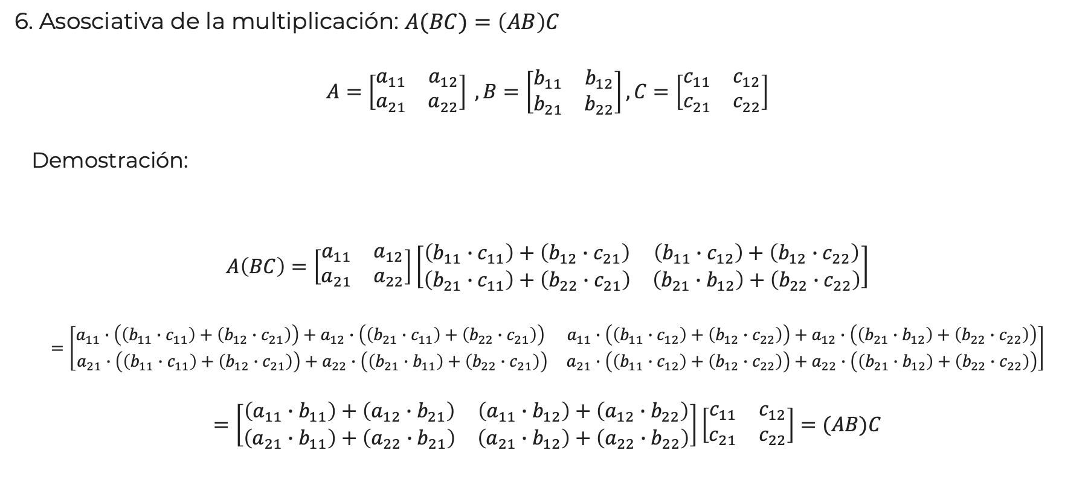
Propiedades de las Operaciones
6. Asosciativa de la multiplicación: $A(BC)=\left(AB\right)C$
$$A=\left[\begin{matrix}a_{11} & a_{12} \\ a_{21} & a_{22}\end{matrix}\right] , B=\left[\begin{matrix}b_{11} & b_{12} \\ b_{21} & b_{22}\end{matrix}\right],C=\left[\begin{matrix}c_{11} & c_{12} \\ c_{21} & c_{22}\end{matrix}\right]$$
Demostración:
$$A\left(BC\right)=\left[\begin{matrix}a_{11} & a_{12} \\ a_{21} & a_{22}\end{matrix}\right]\left[\begin{matrix}\left(b_{11}∙c_{11}\right)+\left(b_{12}∙c_{21}\right) & \left(b_{11}∙c_{12}\right)+\left(b_{12}∙c_{22}\right) \\ \left(b_{21}∙c_{11}\right)+\left(b_{22}∙c_{21}\right) & \left(b_{21}∙b_{12}\right)+\left(b_{22}∙c_{22}\right)\end{matrix}\right]$$
$$=\left[\begin{matrix}a_{11}∙\left(\left(b_{11}∙c_{11}\right)+\left(b_{12}∙c_{21}\right)\right)+a_{12}∙\left(\left(b_{21}∙c_{11}\right)+\left(b_{22}∙c_{21}\right)\right) & a_{11}∙\left(\left(b_{11}∙c_{12}\right)+\left(b_{12}∙c_{22}\right)\right)+a_{12}∙\left(\left(b_{21}∙b_{12}\right)+\left(b_{22}∙c_{22}\right)\right) \\ a_{21}∙\left(\left(b_{11}∙c_{11}\right)+\left(b_{12}∙c_{21}\right)\right)+a_{22}∙\left(\left(b_{21}∙b_{11}\right)+\left(b_{22}∙c_{21}\right)\right) & a_{21}∙\left(\left(b_{11}∙c_{12}\right)+\left(b_{12}∙c_{22}\right)\right)+a_{22}∙\left(\left(b_{21}∙b_{12}\right)+\left(b_{22}∙c_{22}\right)\right)\end{matrix}\right]$$
$$=\left[\begin{matrix}\left(a_{11}∙b_{11}\right)+\left(a_{12}∙b_{21}\right) & \left(a_{11}∙b_{12}\right)+\left(a_{12}∙b_{22}\right) \\ \left(a_{21}∙b_{11}\right)+\left(a_{22}∙b_{21}\right) & \left(a_{21}∙b_{12}\right)+\left(a_{22}∙b_{22}\right)\end{matrix}\right]\left[\begin{matrix}c_{11} & c_{12} \\ c_{21} & c_{22}\end{matrix}\right]=(AB)C$$

Slide 13
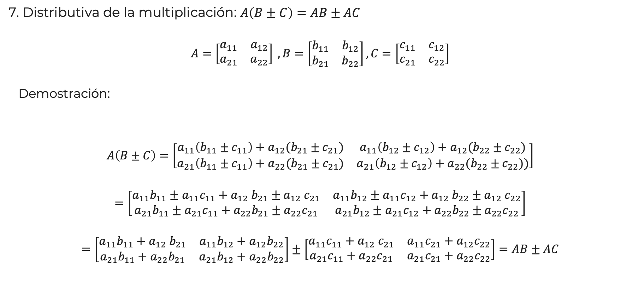
Propiedades de las Operaciones
7. Distributiva de la multiplicación: $A\left(B±C\right)=AB±AC$
$$A=\left[\begin{matrix}a_{11} & a_{12} \\ a_{21} & a_{22}\end{matrix}\right] , B=\left[\begin{matrix}b_{11} & b_{12} \\ b_{21} & b_{22}\end{matrix}\right],C=\left[\begin{matrix}c_{11} & c_{12} \\ c_{21} & c_{22}\end{matrix}\right]$$
Demostración:
$$A\left(B±C\right)=\left[\begin{matrix}a_{11}\left(b_{11}±c_{11}\right)+a_{12}(b_{21}±c_{21}) & {a_{11}\left(b_{12}±c_{12}\right)+a}_{12}(b_{22}±c_{22}) \\ a_{21}\left(b_{11}±c_{11}\right)+a_{22}(b_{21}±c_{21}) & {a_{21}\left(b_{12}±c_{12}\right)+a}_{22}(b_{22}±c_{22}))\end{matrix}\right]$$
$$=\left[\begin{matrix}a_{11}b_{11}±a_{11}c_{11}+a_{12} b_{21}±a_{12} c_{21} & a_{11}b_{12}±a_{11}c_{12}+a_{12} b_{22}±a_{12} c_{22} \\ a_{21}b_{11}±a_{21}c_{11}+a_{22}b_{21}±a_{22}c_{21} & a_{21}b_{12}±a_{21}c_{12}+a_{22}b_{22}±a_{22}c_{22}\end{matrix}\right]$$
$$=\left[\begin{matrix}a_{11}b_{11}+a_{12} b_{21} & a_{11}b_{12}+a_{12}b_{22} \\ a_{21}b_{11}+a_{22}b_{21} & a_{21}b_{12}+a_{22}b_{22}\end{matrix}\right]±\left[\begin{matrix}a_{11}c_{11}+a_{12} c_{21} & a_{11}c_{21}+a_{12}c_{22} \\ a_{21}c_{11}+a_{22}c_{21} & a_{21}c_{21}+a_{22}c_{22}\end{matrix}\right]=AB±AC$$

Slide 14

Matriz Transpuesta
Si $A=\left[a_{ij}\right]$ y la matriz $A^{T}=[a_{ji}]$
$$A=\left[\begin{matrix}a_{11} & a_{12} & … \\ a_{21} & a_{22} & … \\ \begin{matrix}⋮ \\ a_{m1}\end{matrix} & \begin{matrix}⋮ \\ a_{m2}\end{matrix} & \begin{matrix}⋱ \\ …\end{matrix}\end{matrix} \begin{matrix}a_{1n} \\ a_{11} \\ \begin{matrix}⋮ \\ a_{mn}\end{matrix}\end{matrix}\right] A^{T}=\left[\begin{matrix}a_{11} & a_{22} & … \\ a_{12} & a_{22} & … \\ \begin{matrix}⋮ \\ a_{1n}\end{matrix} & \begin{matrix}⋮ \\ a_{2n}\end{matrix} & \begin{matrix}⋱ \\ …\end{matrix}\end{matrix} \begin{matrix}a_{m1} \\ a_{m2} \\ \begin{matrix}⋮ \\ a_{mn}\end{matrix}\end{matrix}\right]$$
Propiedades:
${\left(A^{T}\right)}^{T}=A$
${{\left(A+B\right)}^{T}=A}^{T}+B^{T}$
$\left(cA^{T}\right)=cA^{T}$
${\left(AB\right)}^{T}=B^{T}A^{T}$
Si $A=A^{T}$ entonces $A$ es una matriz simétrica
Si $B=AA^{T}={\left(AA^{T}\right)}^{T}$ entonces $B$ es una matriz simétrica

Slide 15

Matriz Inversa
Una matriz $A_{(n x n)}$ es invertible (no singular) si existe una matriz $B_{(n x n)}$ tal que
$$AB=BA=I$$
Propiedades:
${\left(A^{−1}\right)}^{−1}=A$
${\left(A^{k}\right)}^{−1} ={\left(A^{−1}\right)}^{k}$
${\left(cA\right)}^{−1}=\frac{1}{c}A^{−1}$
${\left(A^{T}\right)}^{−1}={\left(A^{−1}\right)}^{T}$
${\left(AC\right)}^{−1}=C^{−1}A^{−1}$
$B_{(n x n)}$ recibe el nombre de inversa multiplicativa y, si existe, es única.

